Slide 1
Sensitivity Analysis and Model Evaluation of Bifenthrin Surface Water Concentrations from California Urban Runoff
Emma Chelsvigª, Frederick Ayiviª, Yuzhou Luo^{b}, Debra Denton^{c}, Ann Pitchford^{d}, Sandy Raimondo^{e}, Donald Ebert^{e}, S. Thomas Purucker^{e}, Yongping Yuan^{e}
ªOak Ridge Institute of Science and Engineering (Chelsvig.Emma@epa.gov, frederickayivi@gmail.com)
^{b}California Department of Pesticide Regulation (Yuzhou.Luo@cdpr.ca.gov)
^{c}U.S. Environmental Protection Agency Region 9 (Denton.Debra@epa.gov)
^{d}Retiree, previously U.S. Environmental Protection Agency, Office of Research and Development (pitchford3@cox.net)
^{e}U.S. Environmental Protection Agency, Office of Research and Development (Raimondo.Sandy@epa.gov, Ebert.Donald@epa.gov, Purucker.Tom@epa.gov, Yuan.Yongping@epa.gov)

Slide 2
Goals
Employ deterministic and probabilistic approaches with PWC to simulate bifenthrin concentration in runoff
Assess urban contributions to surface water concentrations of bifenthrin
Identify sensitive inputs with respect to model output variability

Slide 3

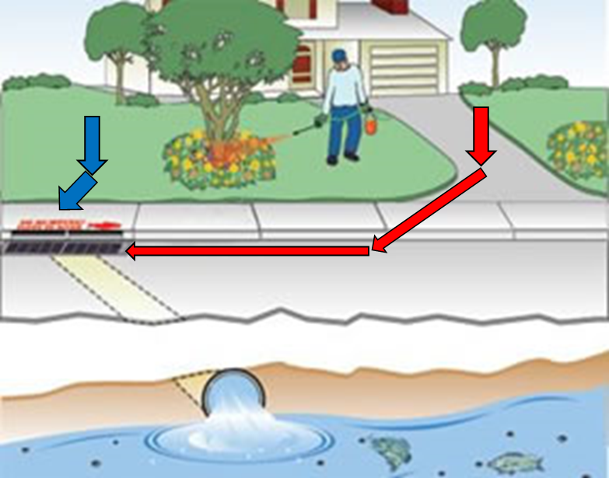
Study Overview
Sacramento-San Joaquin River Delta
Habitat for fish and invertebrate species
Experiencing habitat loss due to pyrethroid use and its associated pollution
Bifenthrin
Pyrethroid; toxic to Delta species
Used by professional pest control applicators for landscape application or as perimeter treatments to structures
Considerable amount in urban runoff after rain events
Use exposure models (ex., PWC)
Rain

Slide 4
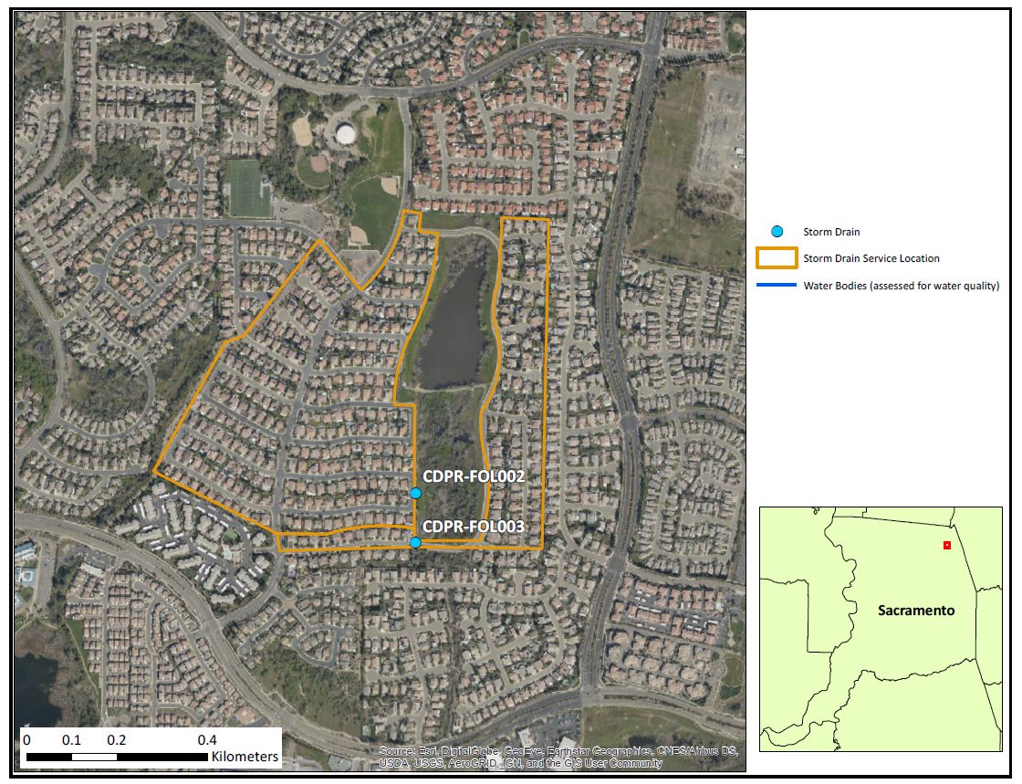
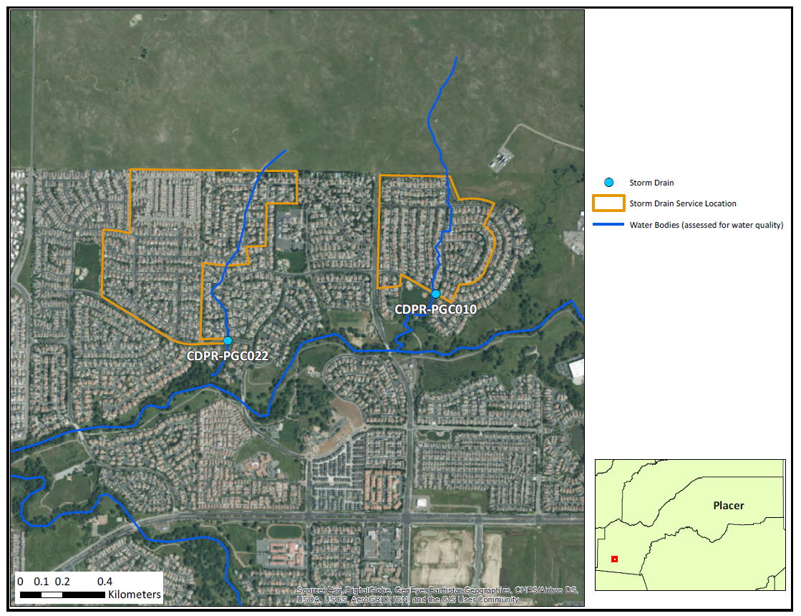
Site Overview

Slide 5
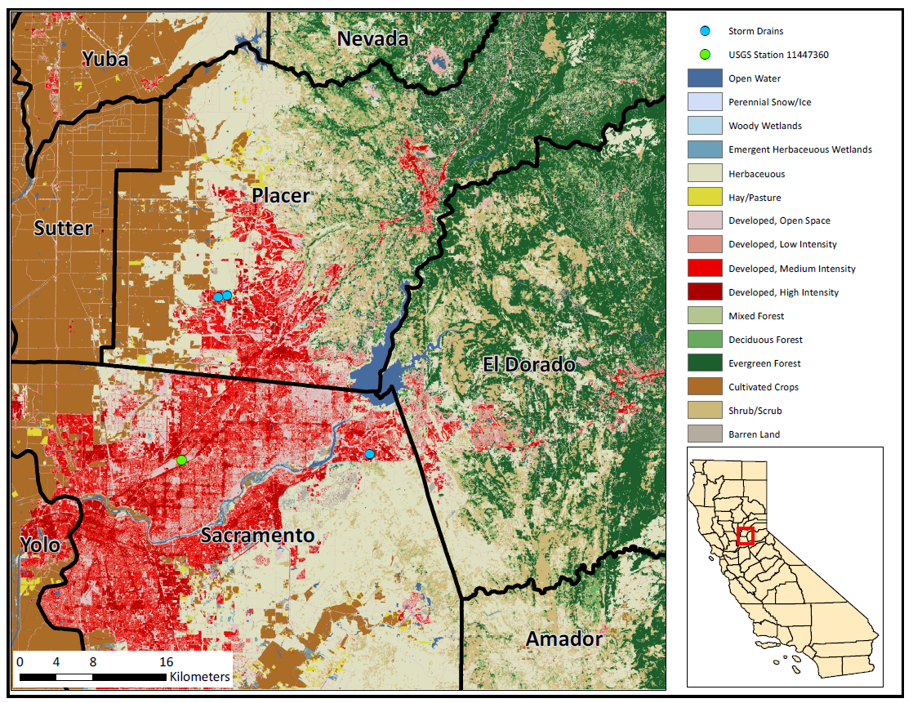

Slide 6

PWC
US EPA Office of Pesticide Program
Simulates pesticide concentration in surface water
Pesticide Root Zone Model (PRZM)
Variable Volume Water Model (VVWM)
Site-specific inputs

Slide 7
Deterministic Model setup
Single value (conservative estimate) for all input parameters
chemical variables, …
Weather file used
Application rate computation (based off CALPIP data + homeowner usage)

Slide 8
Probabilistic Model setup
Use Sumathy’s graphic (create a new one based on my files names and process)
Talk about defining input parameter ranges

Slide 9
Results
Plot showing deterministic output and probabilistic percentiles, with rainfall data

Slide 10
Results
Sensitivity analysis results

Slide 11
Summary
Summarize findings, etc.

